Slide 1
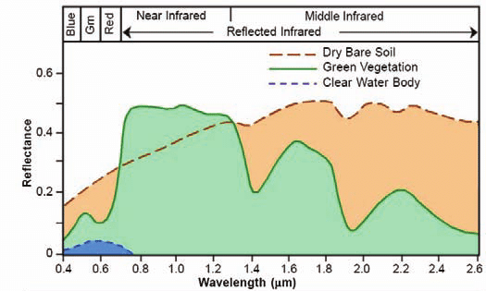
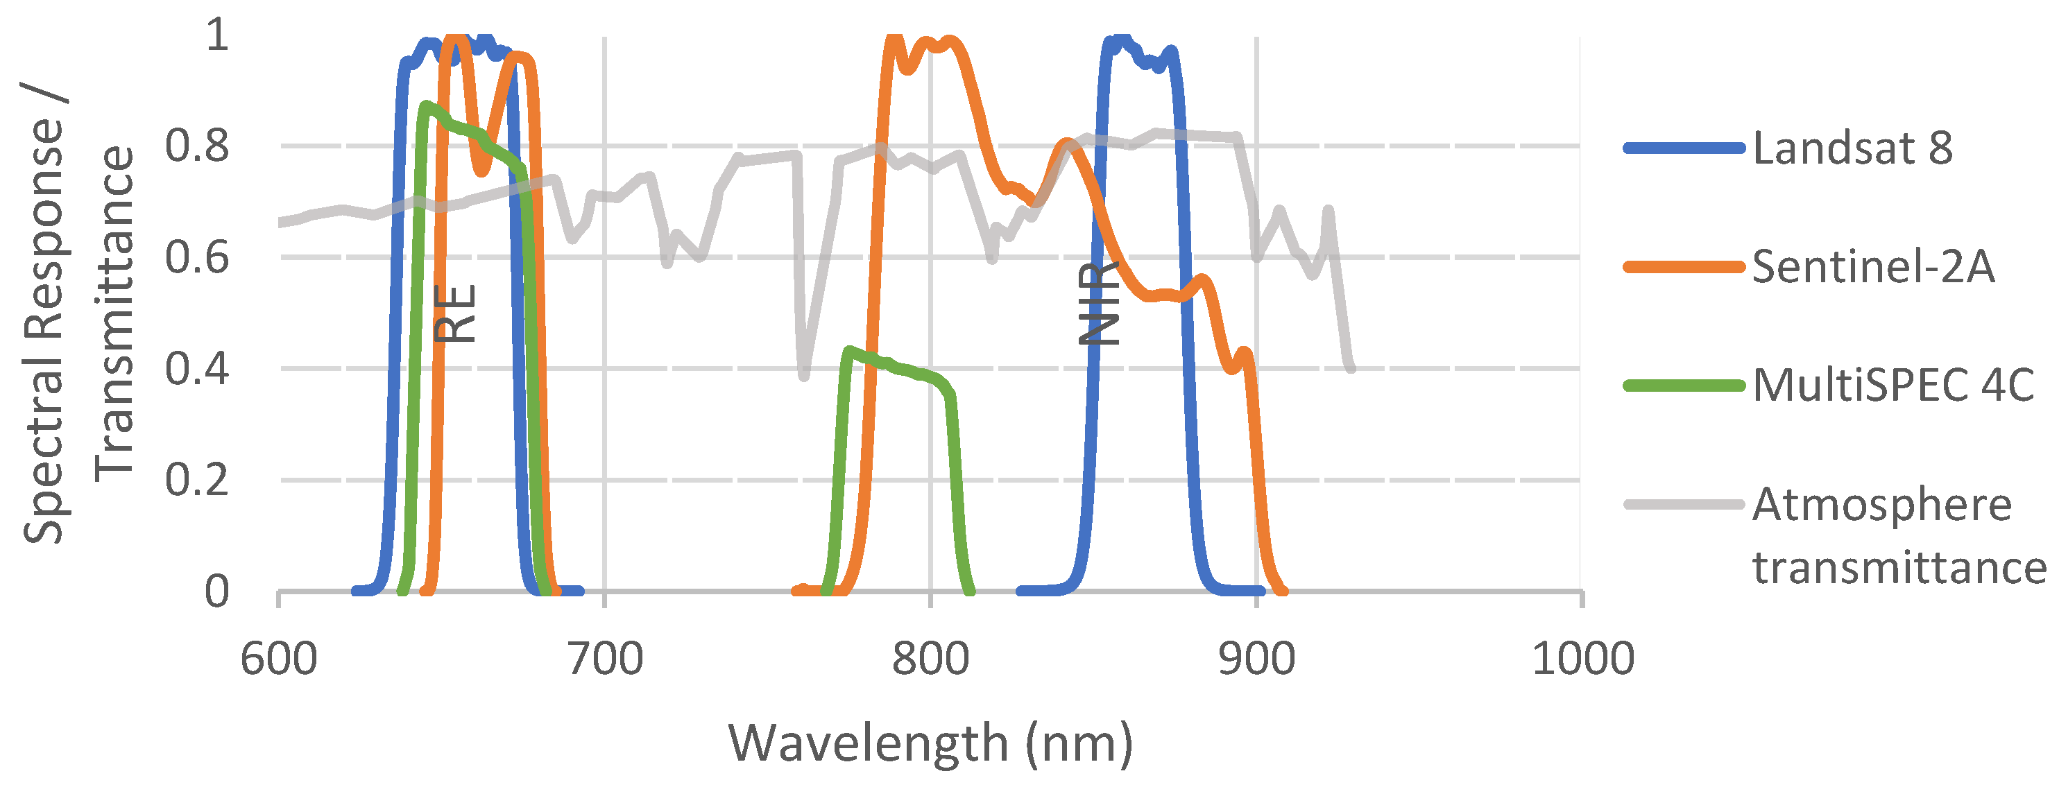
https://ltb.itc.utwente.nl
Moravec et al. 2021
Notes:
https://www.mdpi.com/2072-4292/13/18/3550

Slide 2
Ref: [Optical vegetation indices for monitoring terrestrial ecosystems globally](https://www.nature.com/articles/s43017-022-00298-5)
Ref: Slide: [Sentinel-2 Data and Vegetation Indices](https://eo4geocourses.github.io/IGIK_Sentinel2-Data-and-Vegetation-Indices/#/)

Slide 3
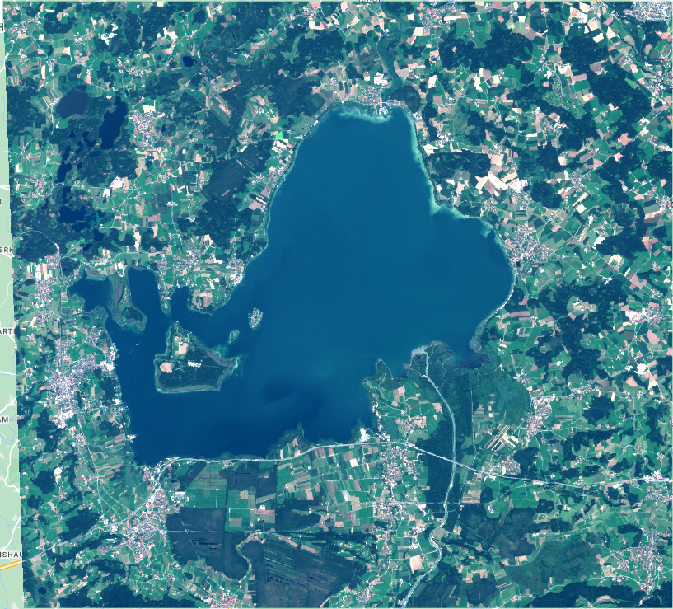
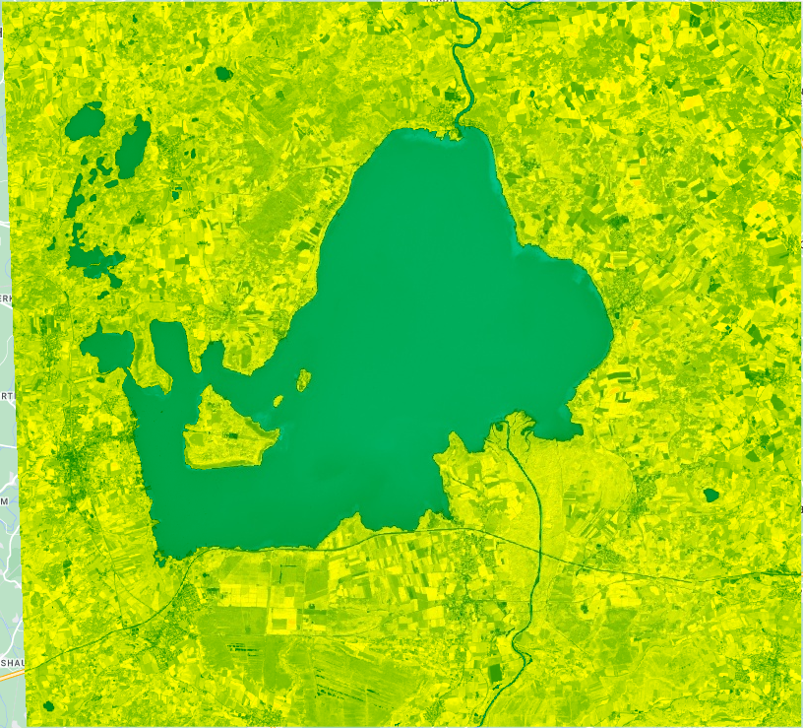
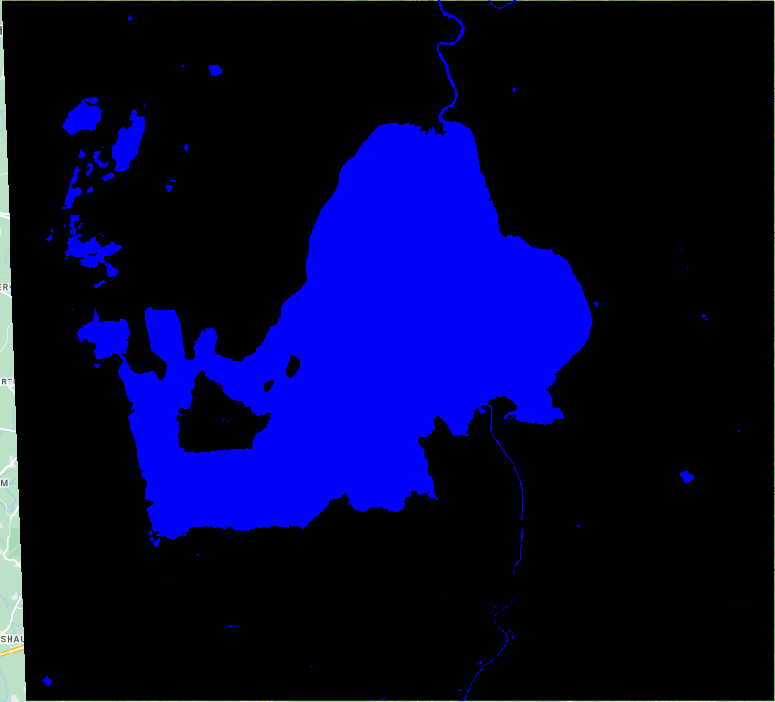
Sentinel-2
NDWI
Water

Slide 4
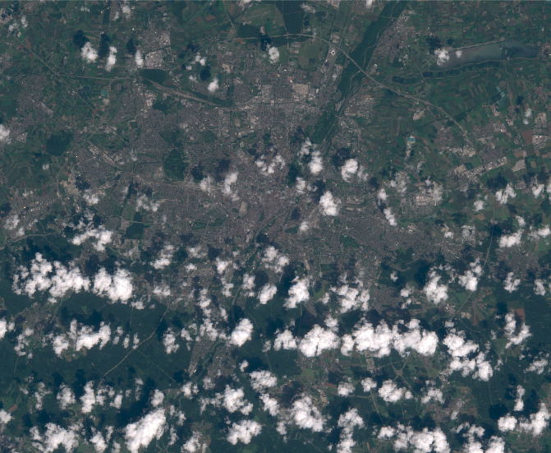
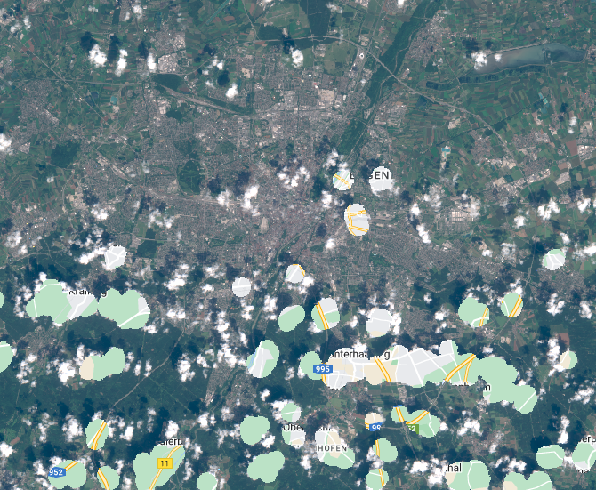
Sentinel-2
Sentinel-2 cloud masked

